Slide 1
TRADING VIA IMAGE CLASSIFICATION
MGMT 590 - MACHINE LEARNING

Slide 2


TEAM – MORE TO TRADING
Sai Teja Pasula
Gopi Krishna Mashetty

Slide 3
Table of contents
01
02
03
04
INTRODUCTION
TRADING STRATEGIES
conclusion
modeling

Slide 4
01
INTRODUCTION
Problem Statement

Slide 5






PROBLEM STATEMENT
Can we build a new system that replicates the way humans trade?
Investors make trading decisions using visual representations
Bridging the unrelated areas of quantitative finance and computer vision

Slide 6

02
TRADING STRATEGIES
Bollinger Bands & Relative Strength Index
Source: https://www.freepik.com/premium-vector/trader-desk-illustration_7114269.htm

Slide 7
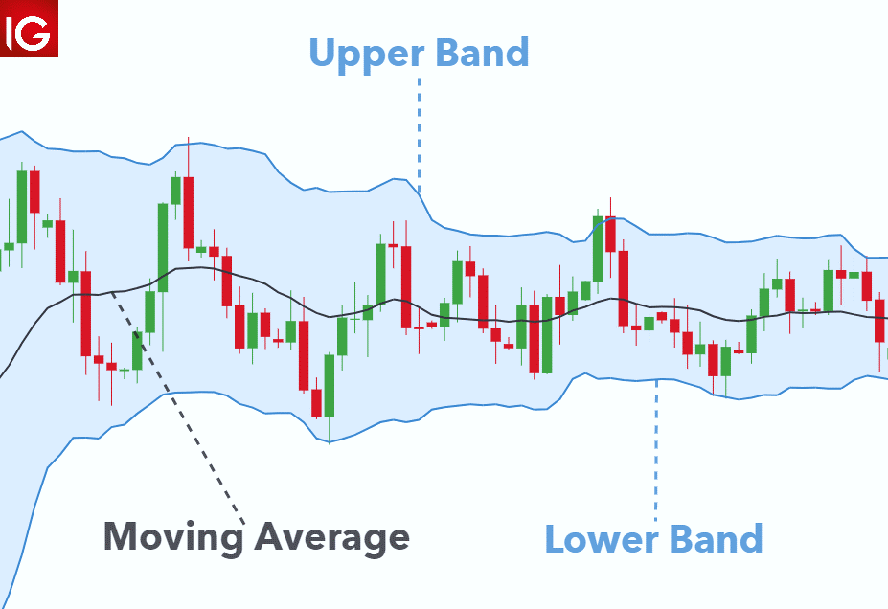
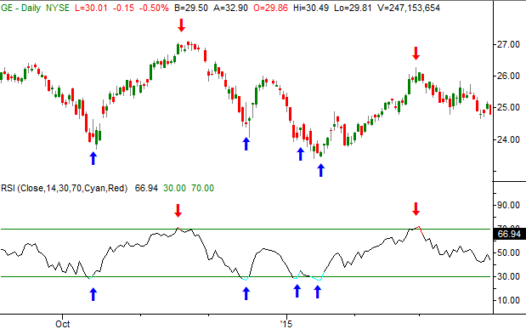
BOLLINGER BANDS
Methodology
20 Days Moving Average
Upper Band: 2 Std. Dev above MA
Lower Band: 2 Std. Dev below MA
Trading Signals
Sell: Candlestick breaks out the UB
Buy: Candlestick breaks out the LB
Source: https://www.dailyfx.com/education/bollinger-bands/forex-trading.html

Slide 8

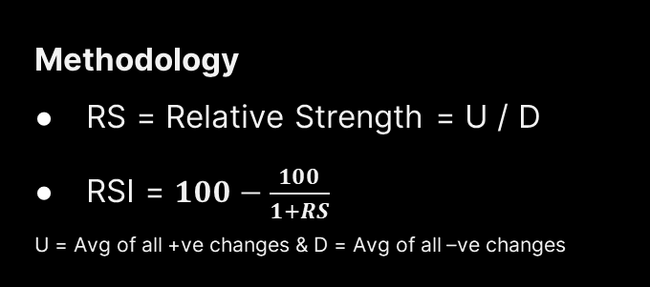
RELATIVE STRENGTH INDEX
Methodology
RS = Relative Strength = U / D
RSI = $100−\frac{100}{1+RS}$
U = Avg of all +ve changes & D = Avg of all –ve changes
Trading Signals
Sell: RSI > 70
Buy: RSI < 30
Source: https://www.bigtrends.com/education/a-1000-gain-on-a-trade-in-less-than-three-months-we-just-did-it-heres-how/

Slide 9

03
MODELING
Image Generation & Classification
Source: https://www.flaticon.com/free-icon/ai_1693746

Slide 10




IMAGE GENERATION
Collected Daily data of S&P 500 Index
Generate the bands and RSI values for the data
1.Data Collection
STEPS
2.Data Preparation
4.Data Partition
3.Signal Generation
Split the data into Training & Validation for the CNN
Use the Bands / RSI values to generate “buy” / “sell” signals

Slide 11
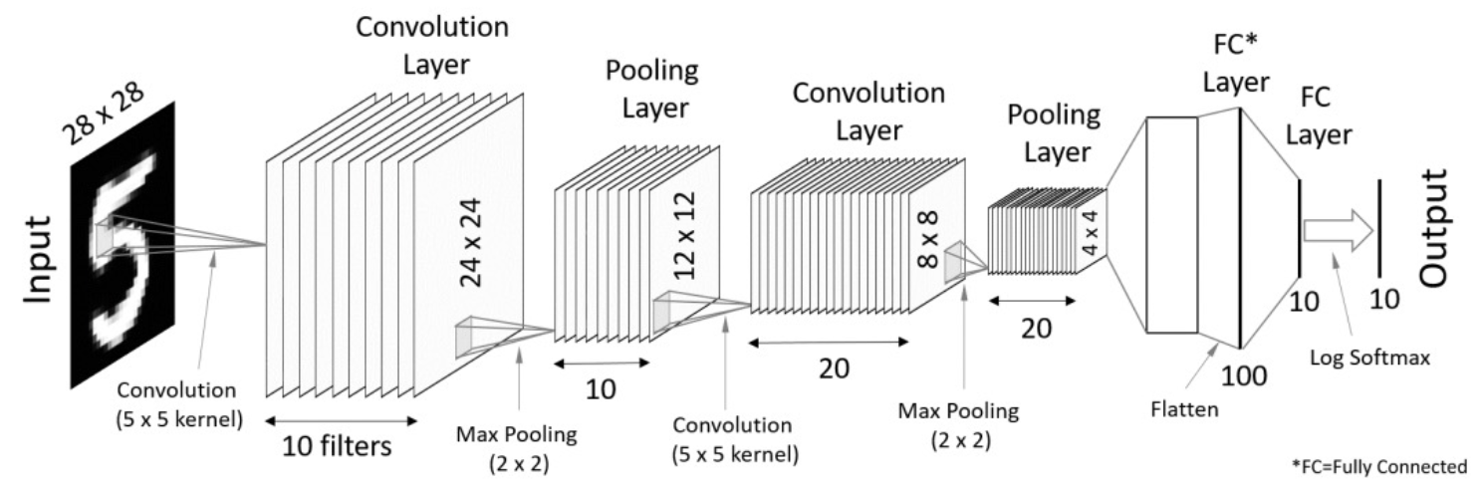
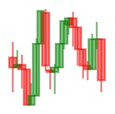
MODEL ARCHITECTURE
Convolution
Layer
Dense Layer
64 x 64 x 3
Pooling
Layer
Convolution
Layer
Pooling Layer
Dense Layer
Output
Input
62 x 62
31 x 31
29 X 29
14 x 14
32
128
2
32
32
Sigmoid
Convolution
(Size 3 Kernel)
6272
32 Filters
Max Pooling
(Size = 2)
Flatten
Max Pooling
(Size = 2)
Convolution
(Size 3 Kernel)

Slide 12
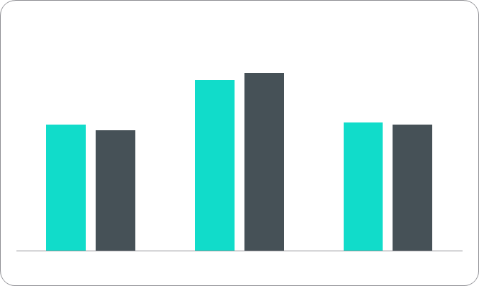
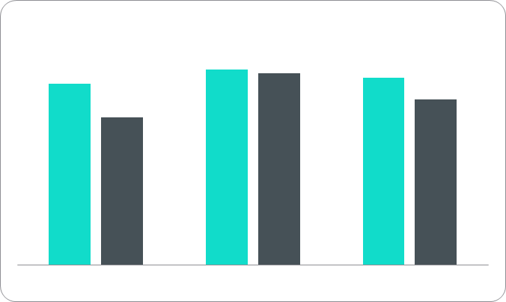
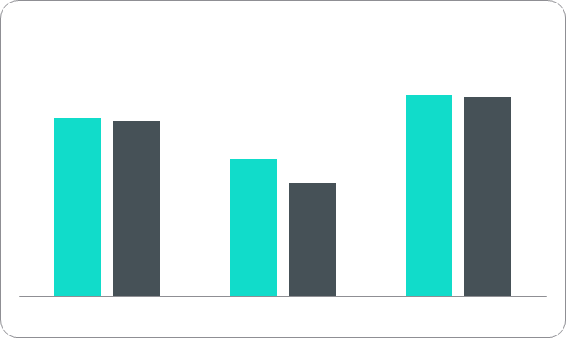
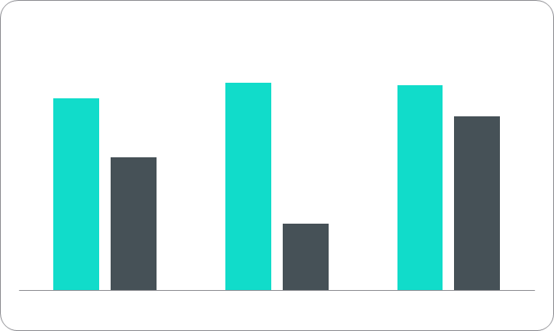
RESULTS
Bollinger Bands Strategy
RSI Strategy
Training
Validation

Slide 13

04
CONCLUSION
Takeaways & Scope
Source: https://www.flaticon.com/free-icon/ai_1693746

Slide 14

TAKEAWAYS & SCOPE
Based on the results of the study, we can conclude that we can build a system that identifies and replicates the way humans trade.
Since 2010, the RSI has performed incredibly well with a median of close to 4% monthly returns for buys.
This model can be improved over time to tell the trader how much to buy/sell, rather than a yes/no for an investment, to maximize the returns.
This model can be developed into a product to assist investment companies on a large scale with high computing capabilities.
Source: https://www.moneyshow.com/articles/tebiwkly08-52167/

Slide 15
thanks!
Any questions?

